Slide 1

Building Client Relationships
wehackpeople.com

Slide 2
Clients
Clients are important.
We need them a little bit.

Slide 3
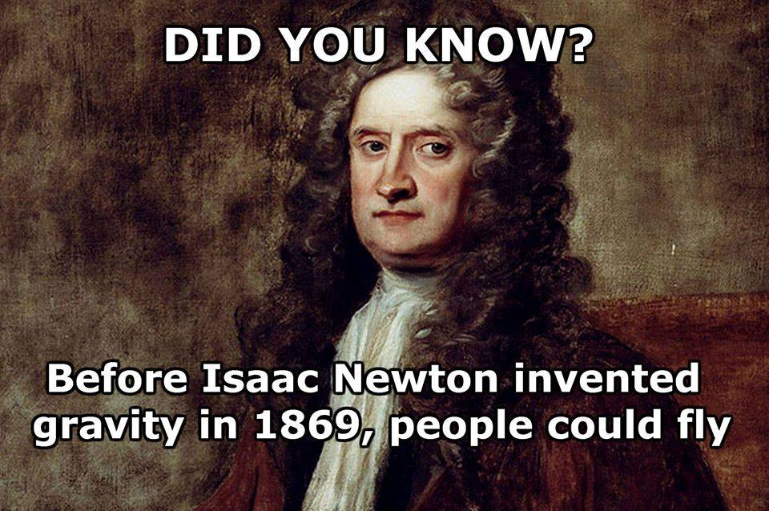

Availability
Be there to answer their questions!
Often talk to them as they are children, and don’t understand basics.
Consider them to be “needy”, but be there for them.
Be willing to provide solid, life-coaching advice!

Slide 4

Listen
Be willing to listen to them for hours!
Be a friend!
It’s okay to remove those personal / business boundaries.

Slide 5
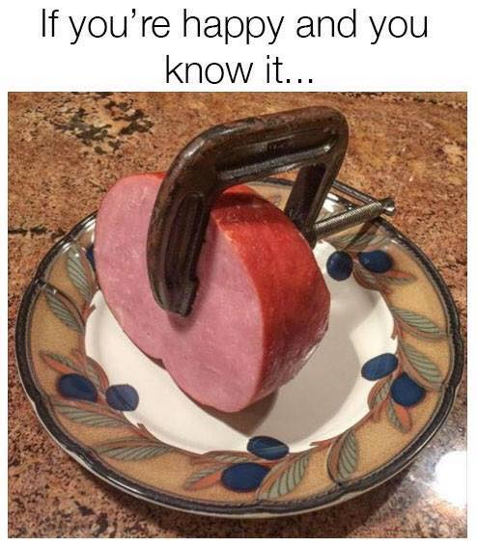
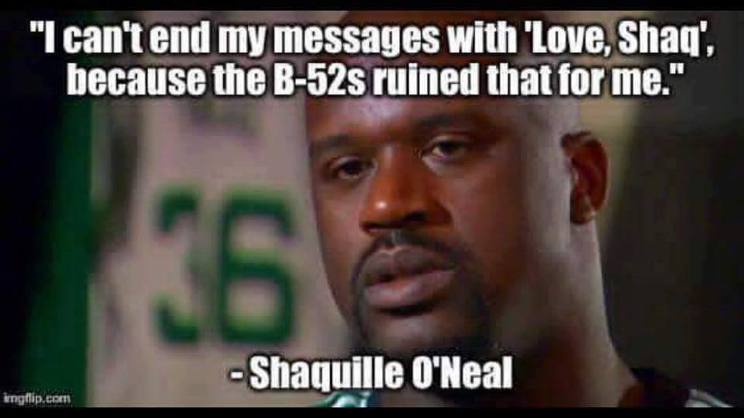
Response!
It’s okay and suggested to laugh at ALL jokes!
Being funny or not doesn’t matter here.
Show sympathy.

Slide 6

Response!
ALWAYS tell the truth, even if inappropriate or hurtful.

Slide 7

Hope & Help!
It’s okay to lead them on, if it helps to make a sale!

